Slide 1
Wireless Security
Name : M. Dhanush
Department : Computer science and Engineering
College : The Kavery engineering college

Slide 2
Problem statement
■ Techniques apply to general, low mobility wireless ad hoc networks
For concreteness, we focus on sensor networks
■ Sensor networks have limited energy and need to save power as much as possible
■How can we use information about traffic in the network to:
Determine when nodes should wake up
Choose routes to address the energy-latency trade- off

Slide 3
PrOpOsed system
STEPS OF PROPOSAL SYSTEM
The steps of proposal system for wireless networking by the RSA p cryptosystem are:- 1- Register user’s MAC address in Mikrotik server. 2- Encryptions MAC address. 3- Send crypto MAC address through access point. 4- Receive Crypto Mac address from server. 5- Decryption MAC address in user’s computer. 6- Encryptions MAC address. 7- Send crypto MAC address through access point. 8- Receive Crypto Mac address from user. 9- Decryption MAC address in Mikrotik server.

Slide 4
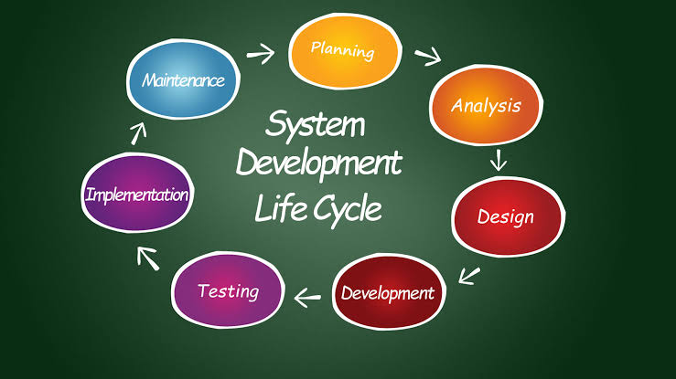
System Development apProach

Slide 5
Algorithm
1) Broadcasting session key by base station, performed in algorithm B,
2) Generation of cryptographic keys in nodes, performed in algorithm A.
3) Transmission of encrypted data from nodes to cluster heads using NOVSF code-hopping technique, performed in algorithm A.
4) Appending the ID# to data and then forwarding it to higher level cluster heads, performed in algorithm A.
5) Decryption and authentication of data by the base station, performed in algorithm B.

Slide 6
Deployment
Follow these steps to deploy wireless access: • Deploy and Configure Wireless Aps • Create a Wireless Users Security Group • Configure Wireless Network (IEEE 802.11) Policies • Configure NPSS
• Join New Wireless Computers to the Domain

Slide 7
Conclusion
• Large number of Wi-Fi systems have been deployed using RC4 algorithm
• WPA-TKIP was introduced to upgrade the existing system without changing the hardware
• However, for better security implemented from ground up, we need AES-CCMP

Slide 8
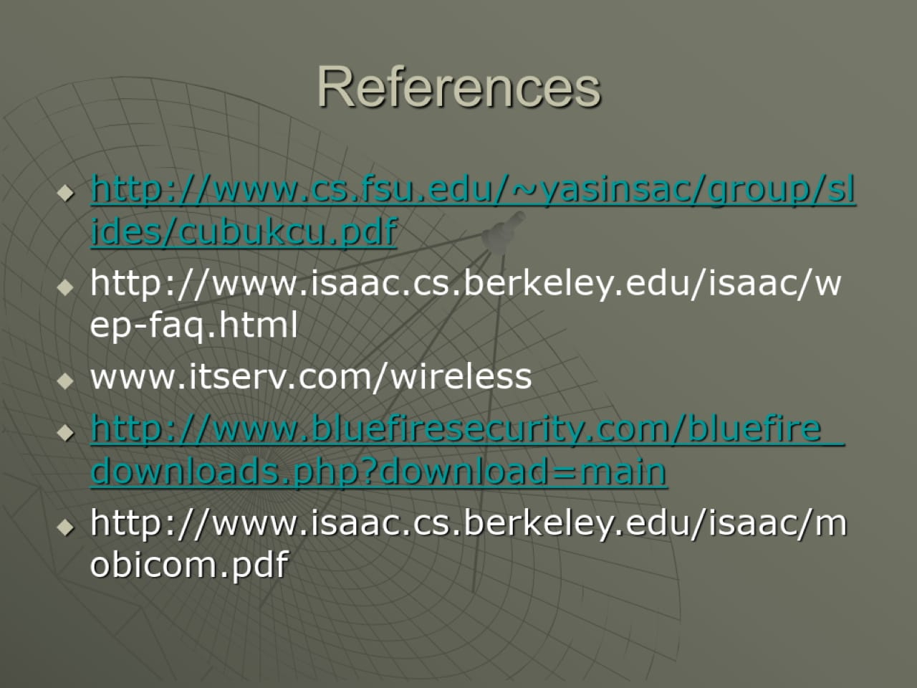

Slide 9


